Slide 1

Flipkart
Jedi
Bootcamp
Presented By: Jedi 04

Slide 2
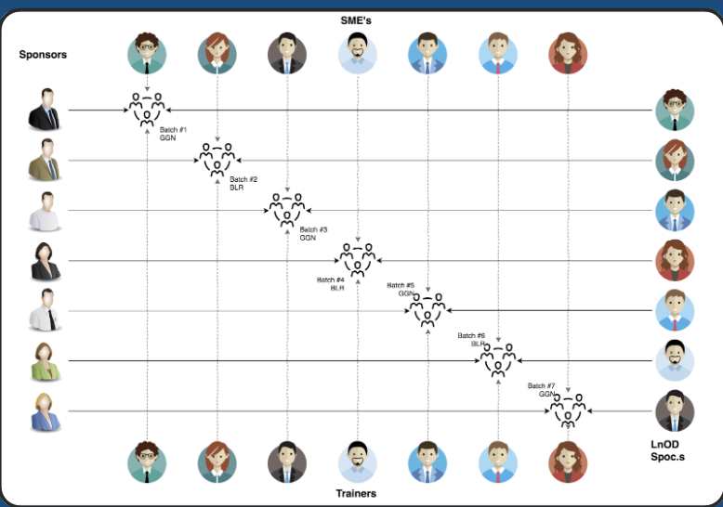
Stakeholders
Sponsors
Flipkart
SMEs
Deepika Gajaraj
Zain Inhonvi Syed Mohammad
Instructors:
Amit Balyan
Shakshi

Slide 3
Framework for 3 weeks
Linux Commands
GIT Commands
SDLC
Java Basics
&
Backend Code
REST API
&
Project Migration
1
3
5
2
4
6
OOAD
UML Modelling
MySQL
DropWizard
&
Project Migration

Slide 4

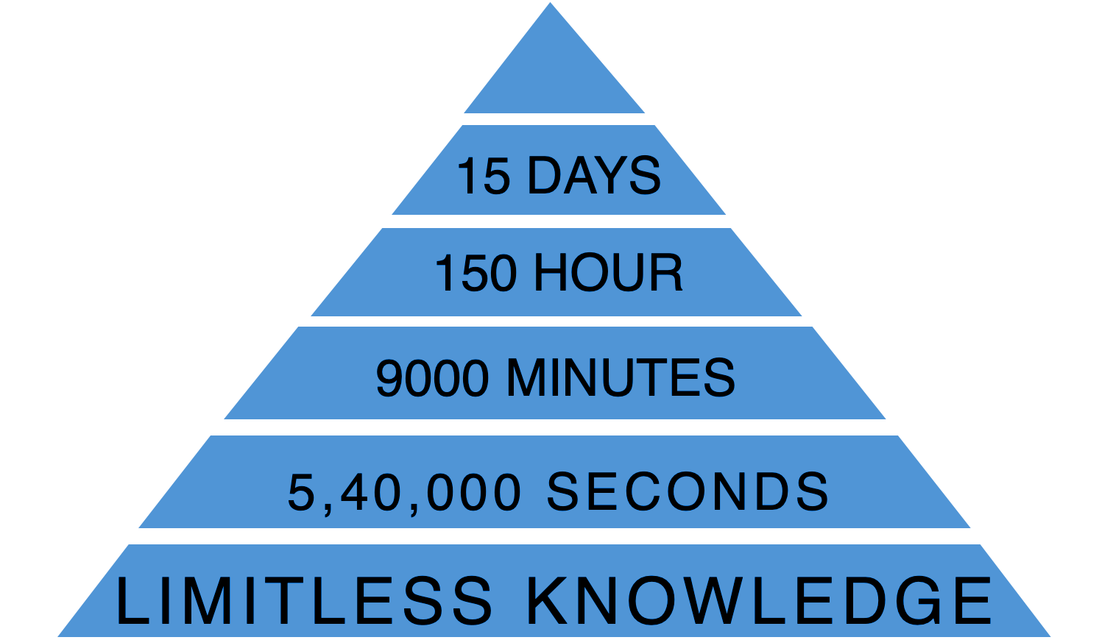
3 Weeks of Training + Project Demo

Slide 5

Agenda
01
Our Journey
02
Our Team
03
Problem Statement
04
Engineering Practices
05
Tech Stack
06
Development
07
Challenges & Learnings
08
Demo
09
Questions
‹#›

Slide 6

Our Journey
Notes:
Time - 2 mins

Slide 7
Step-6
Documentation & Presentation
Step-5
DropWizard Implementation
Step-4
REST API Implementation using Jersey & Tomcat server
Step-3
Java Implementation
Step-2
Making corresponding UML Artifacts
Step-1
Understanding the Problem Statement

Slide 8


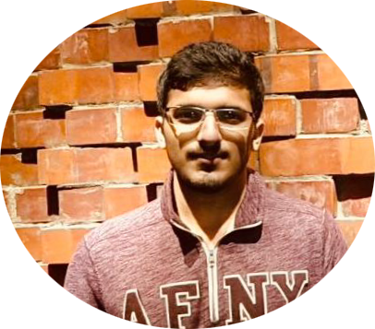


TEAM JEDI 04
Chinmay Sharma
Bhavya Gupta
Ayush Laddha
Partha Paul
Ravi Pandey

Slide 9
Problem
Statement
To develop a course registration system for a university which can be accessed by students professors and Admins of the system.
Student - register for courses, get graded, view their report card.
Professors - grade the students enrolled in their courses.
Admins - manage users, manage courses and approve students for course registration.

Slide 10

Engineering Practices
The Client(Rest), Operation, DAO Pattern.
V Shaped Software Development Life Cycle.
Small iterations => Unit testing => Integration.
Separation of Concerns.

Slide 11




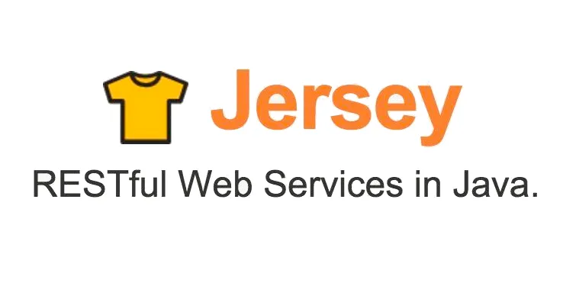




Tech Stack

Slide 12

Development
Notes:
Time – 1 min

Slide 13
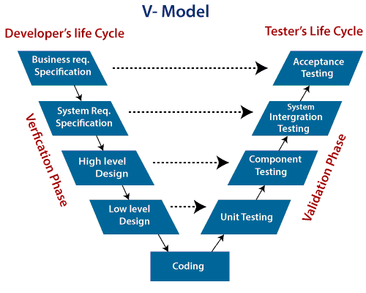
V-Shaped Software Development Life Cycle Model

Slide 14
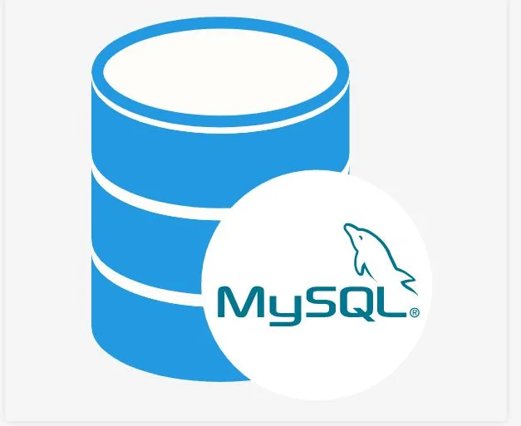

System Architecture
HTTP
Request
HTTP
Response
Java Main Class
(UI)
Business Class
(BC)
Database Class
(UI)

Slide 15

Learnings
&
Challenges
Notes:
Time – 2 mins

Slide 16
Learnings
Got familiarized with Unix commands
Basic Git commands
Software Development Life Cycles
Various UML Diagrams
Java 8 features
Integration of REST services with Java code using Tomcat and Jersey
DropWizard Integration & Advantages
Postman client to test APIs
Generation of Javadoc & basic application monitoring

Slide 17
Challenges
Inter-OS dependency issues
Git merge conflicts
Resolving error due to version mismatch among libraries
Migration of project from one tech stack to another
Database integration challenges

Slide 18

Demo

Slide 19

Thanks!
Any questions?

